Slide 1
CE201 Team 32 NHS Covid App Demonstration of product features
Owen Greene, Bupe Mulenga, Adrian Atirgovitoae, Kiran Bailey-Stokes, Abraham Shodiya
01/12/2021

Slide 2
Program context
This program was requested by the NHS in order to help assist them in keeping track of, and predicting future, Covid-19 data.
We have chosen to display the data in graphical format which helps convey our findings visually and effectively. The graphs are built from scratch and are resizable and they also have clear axis labelling and graph titles.
The user can also make the program display a prediction for how the data will change in the coming weeks.
User stories and further clarity on requirements can be found here
https://cseegit.essex.ac.uk/21-22-ce201-col/21-22_CE201-col_team32/-/blob/master/RequirementsAndRiskLog.md

Slide 3
Individual contributions

Slide 4
Owen Greene

Slide 5
Bupe Mulenga (Wezi)

Slide 6
Adrian Atirgovitoae

Slide 7
Kiran Bailey-Stokes

Slide 8
Abraham Shodiya

Slide 9
Product features

Slide 10
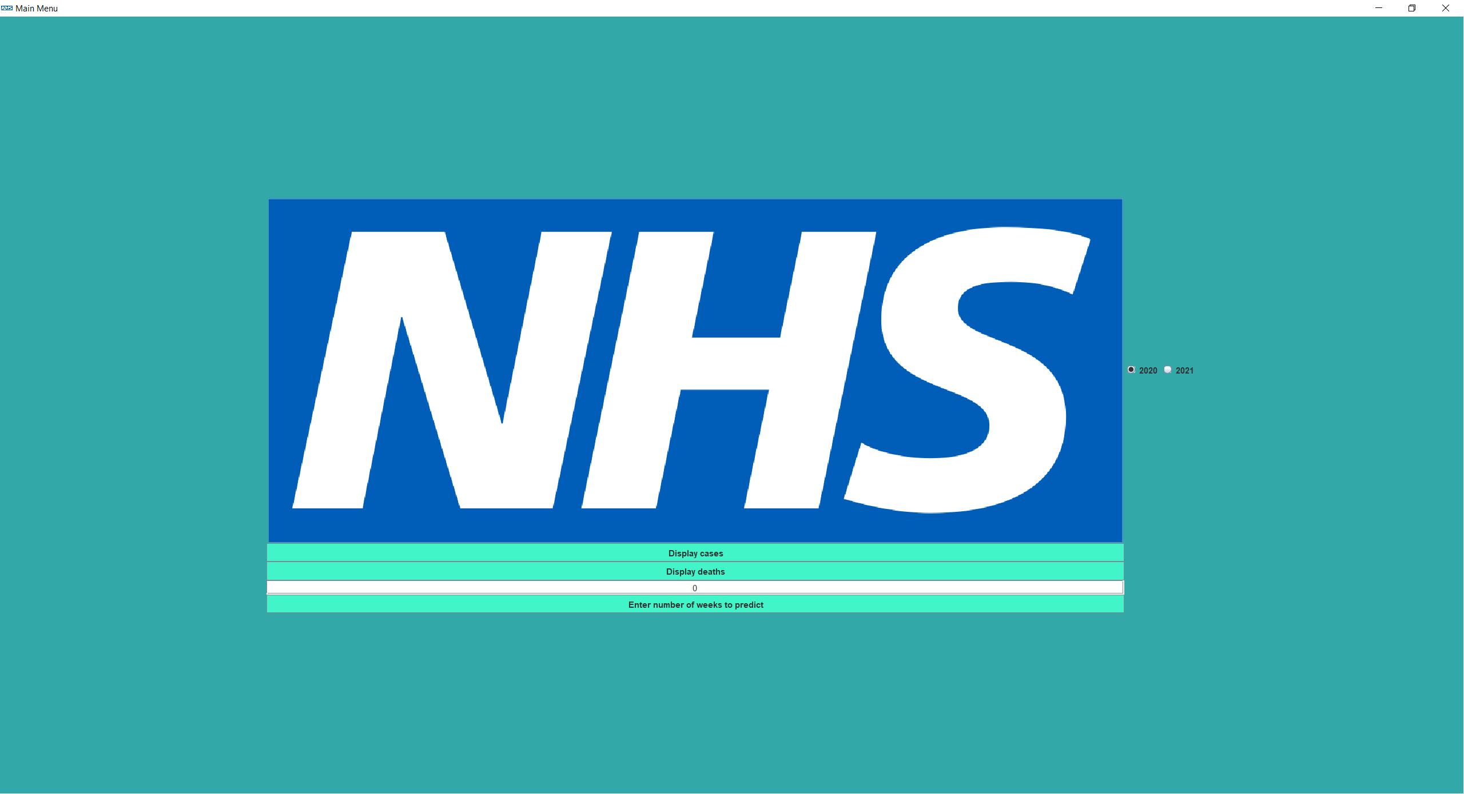
UI (main menu)

Slide 11
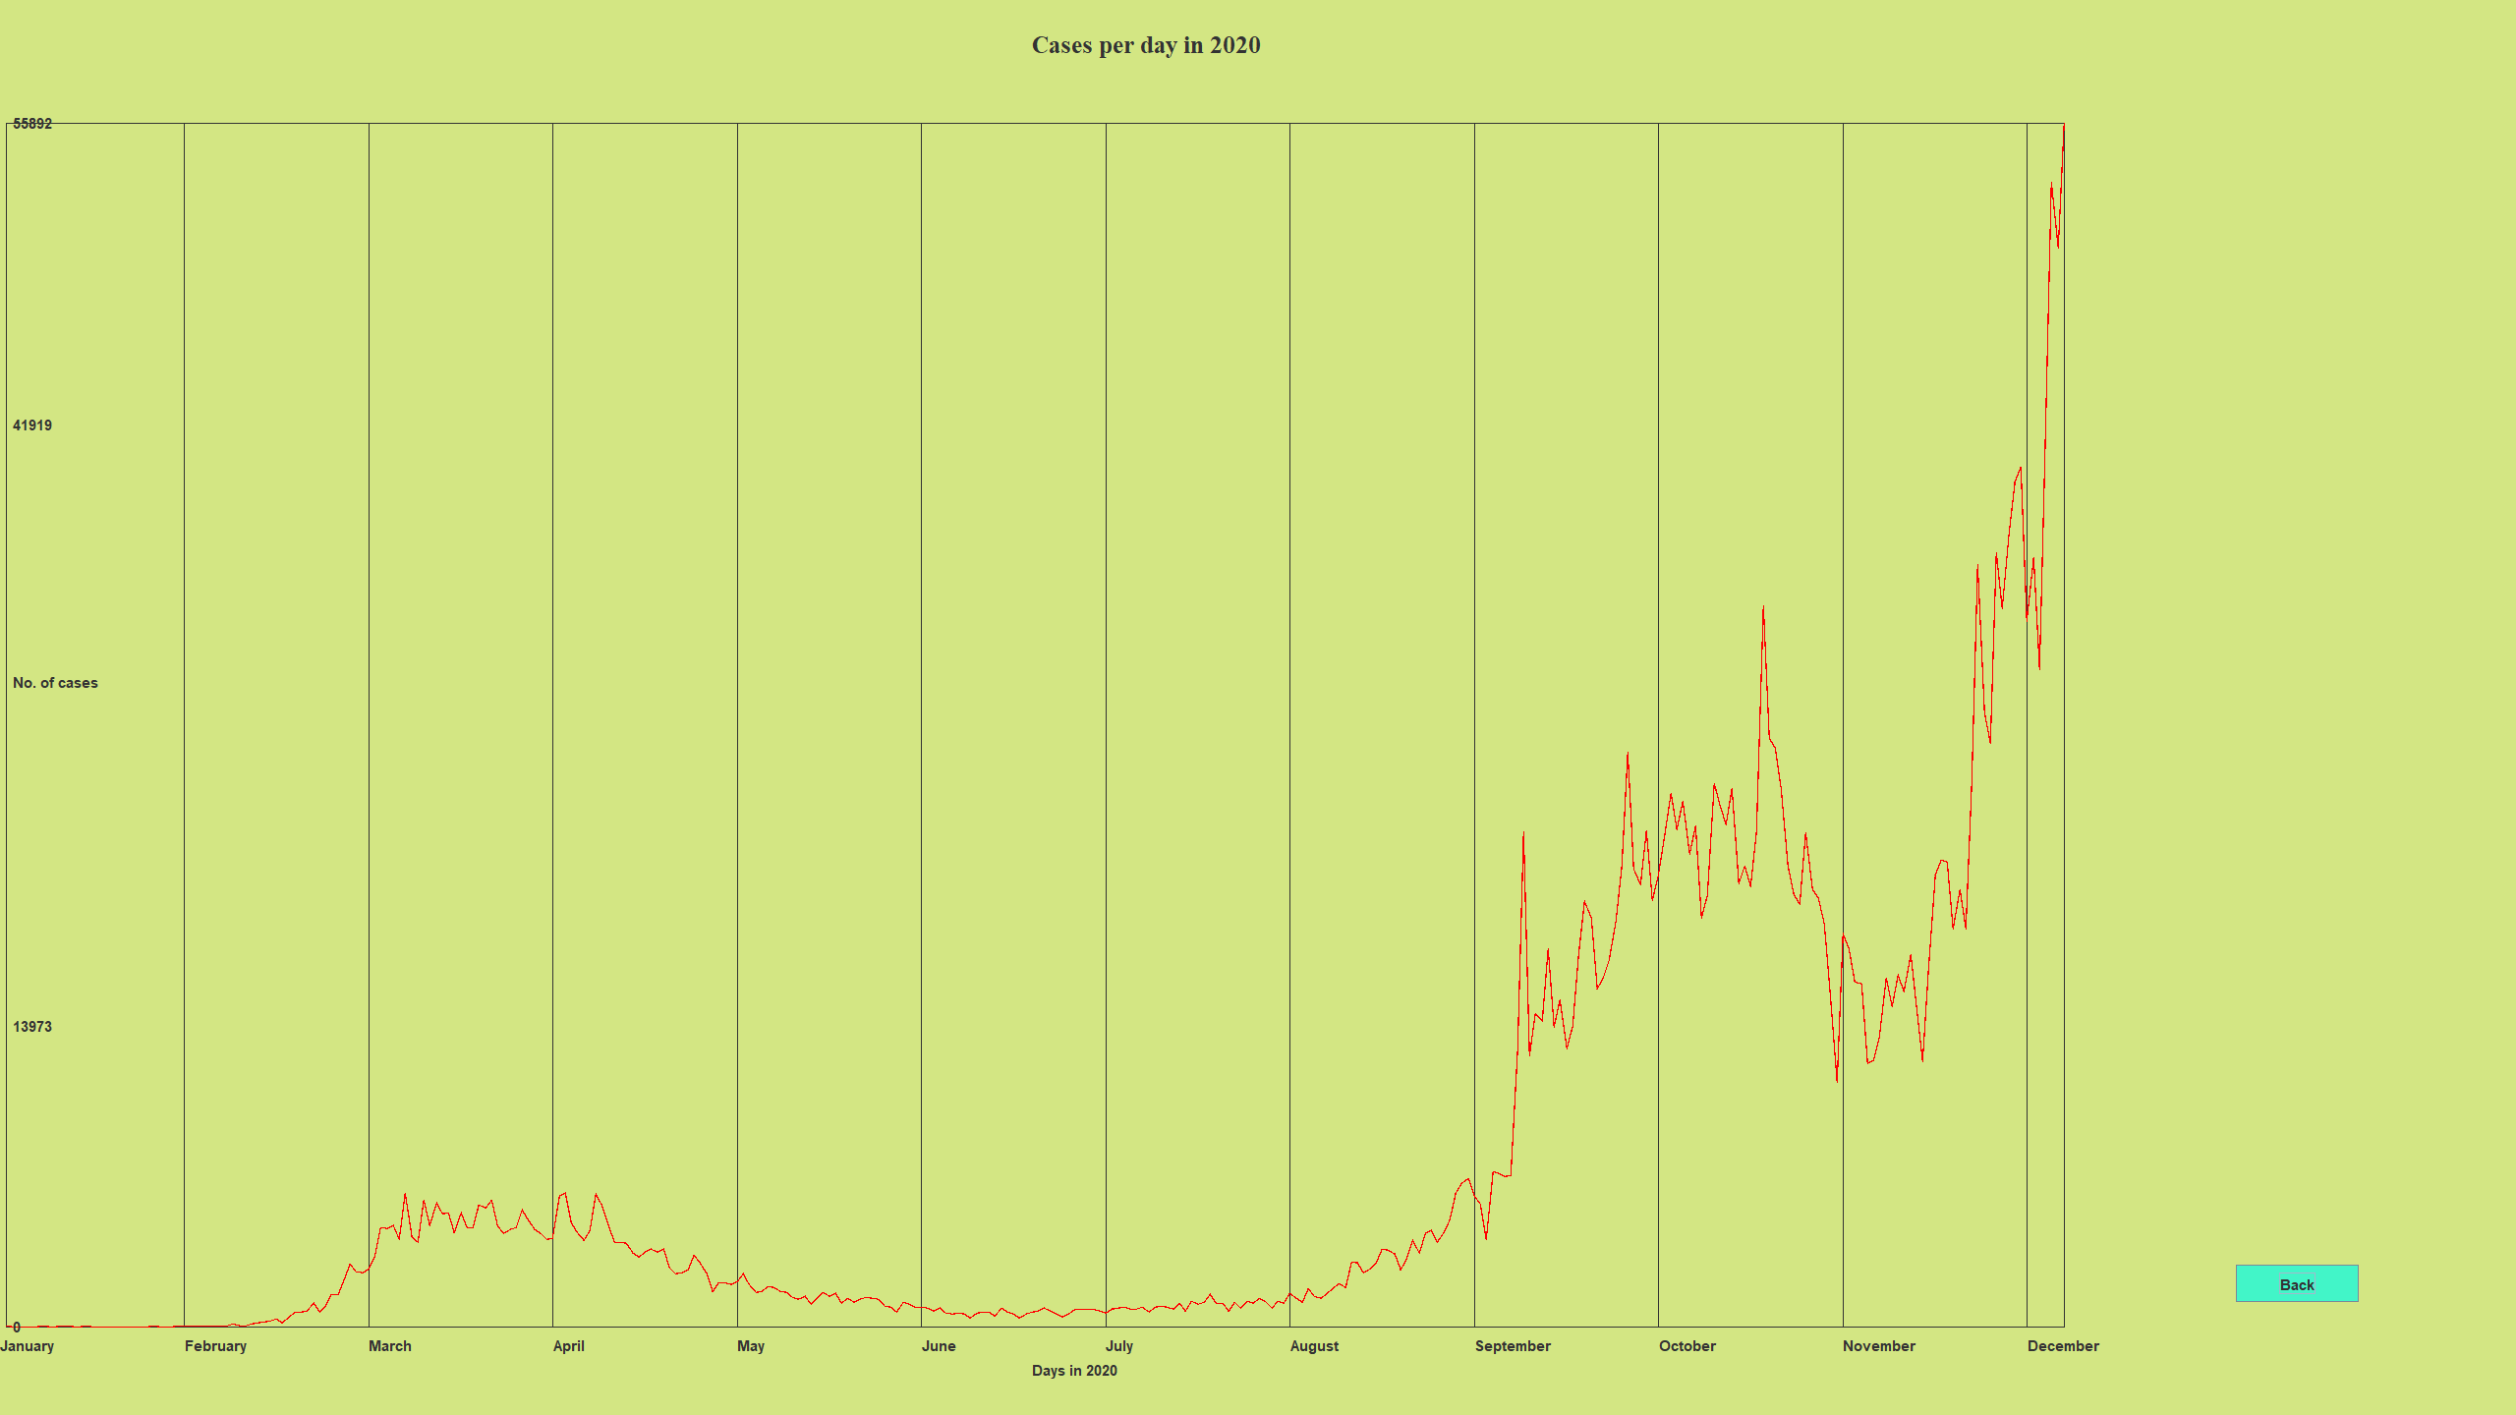
UI (Graphs)

Slide 12
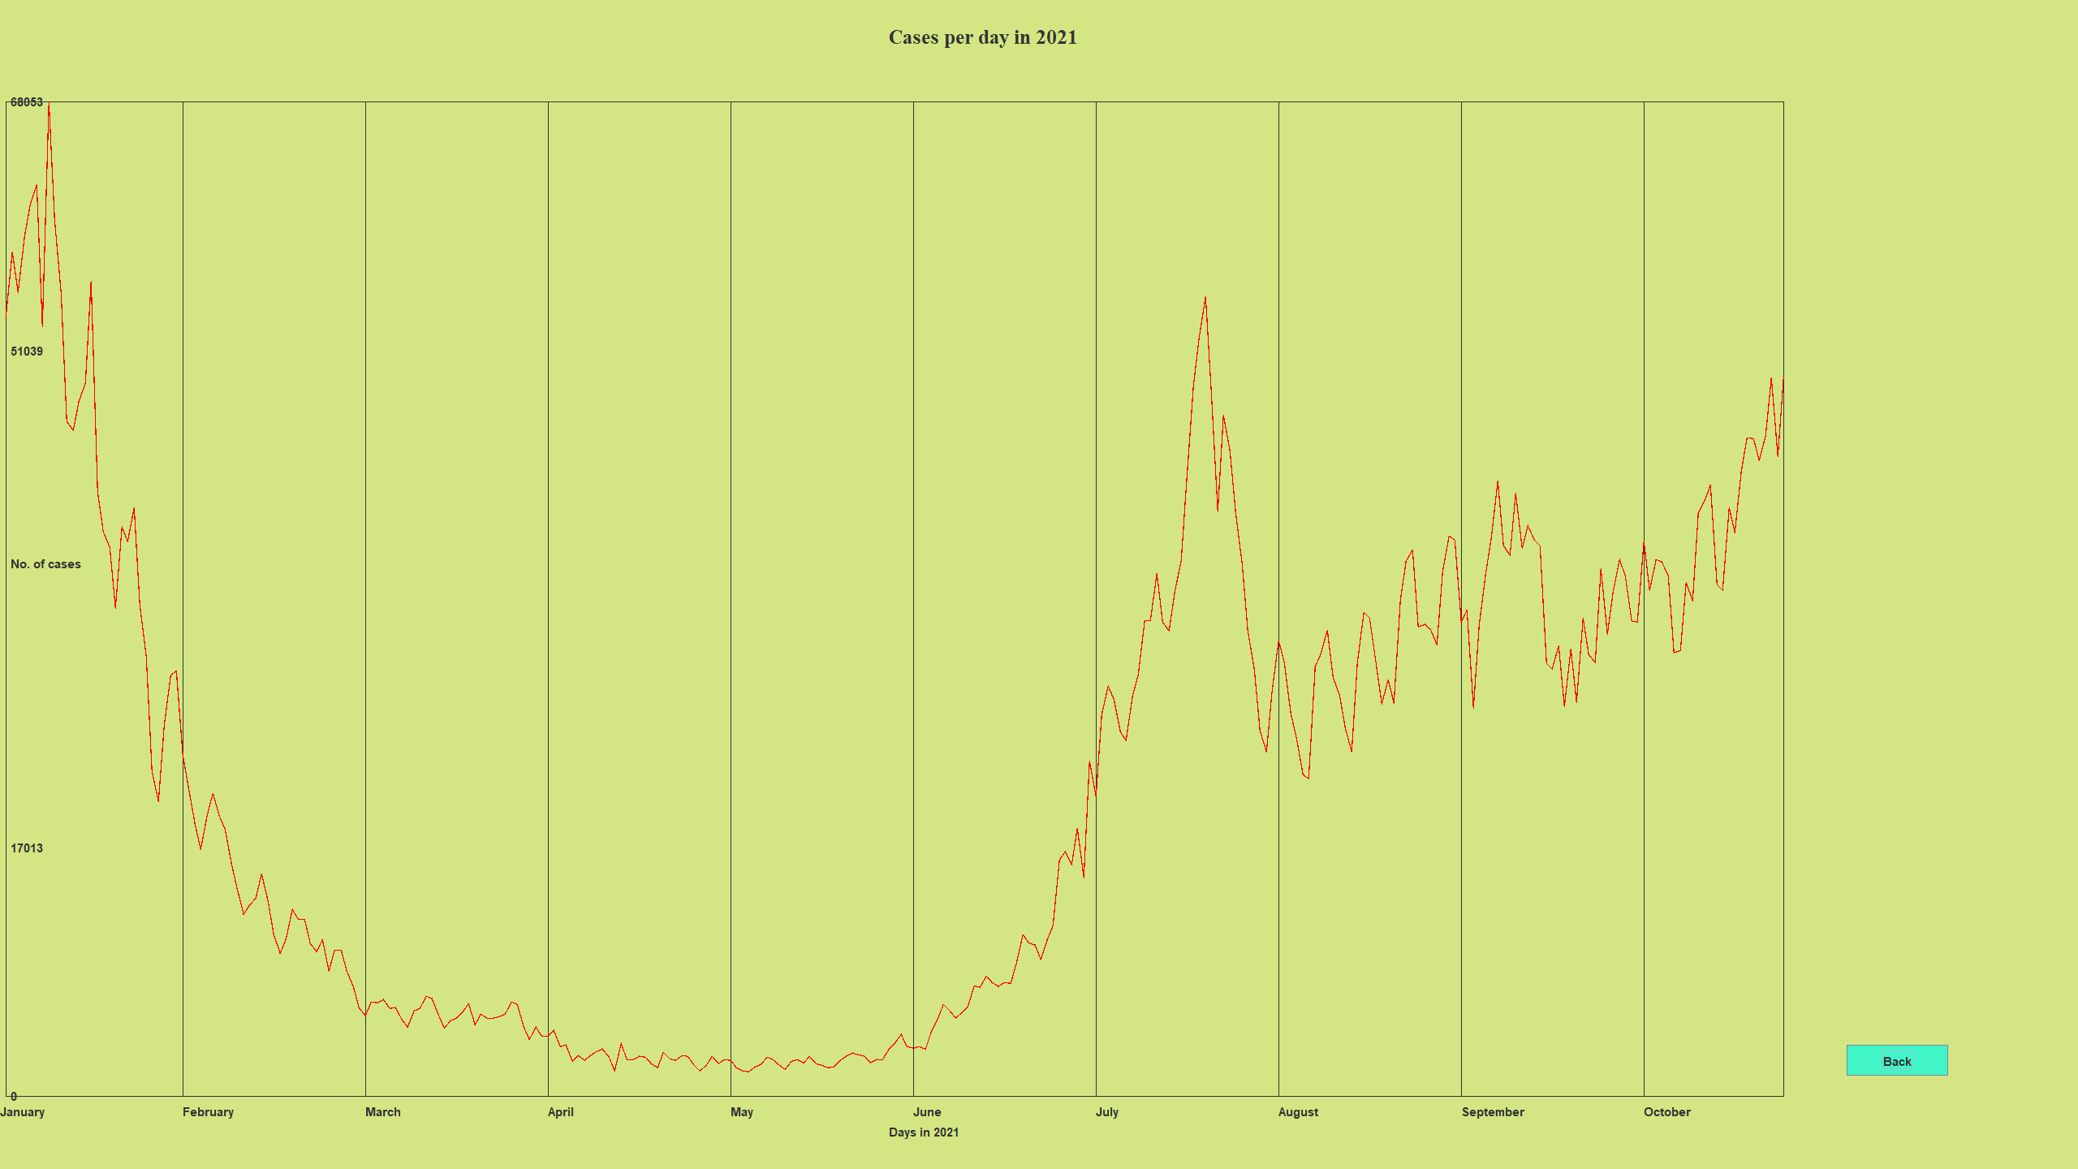
UI (Graphs)

Slide 13
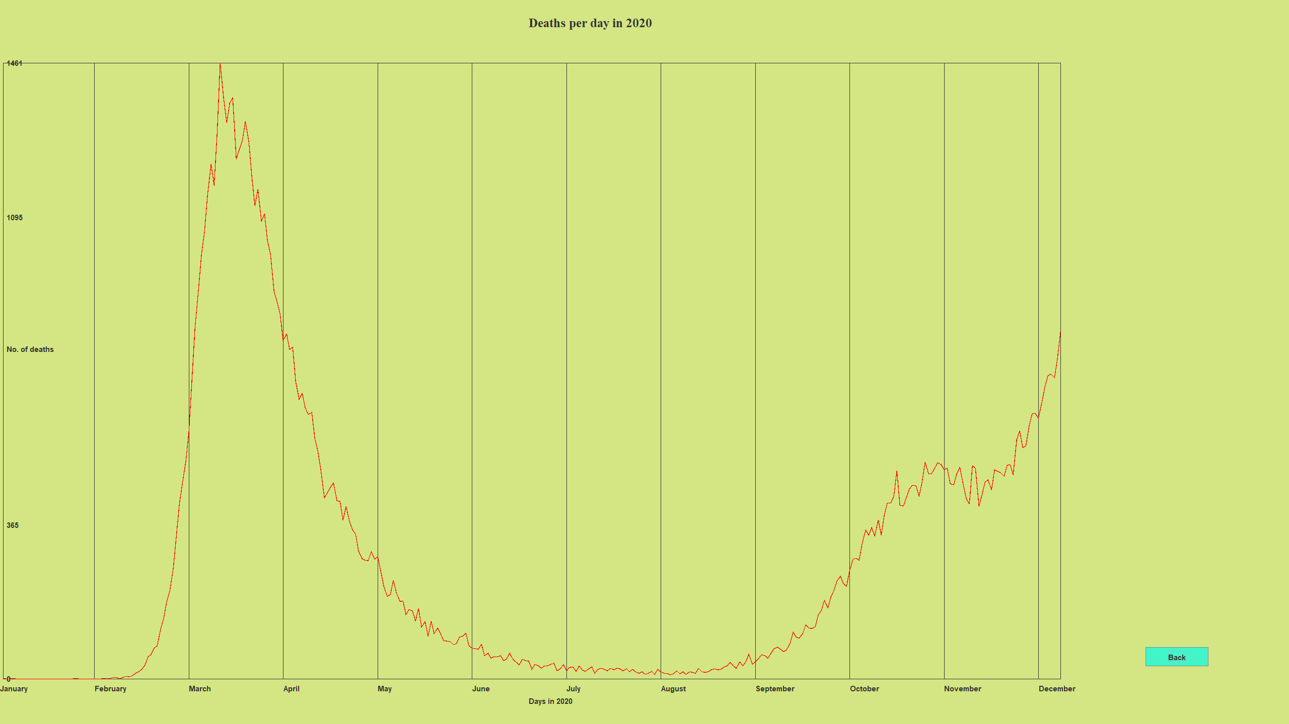
UI (Graphs)

Slide 14
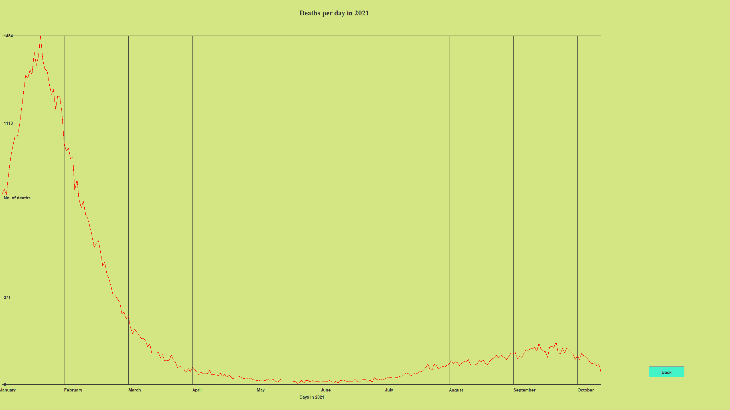
UI (Graphs)

Slide 15

Prediction functionality

Slide 16
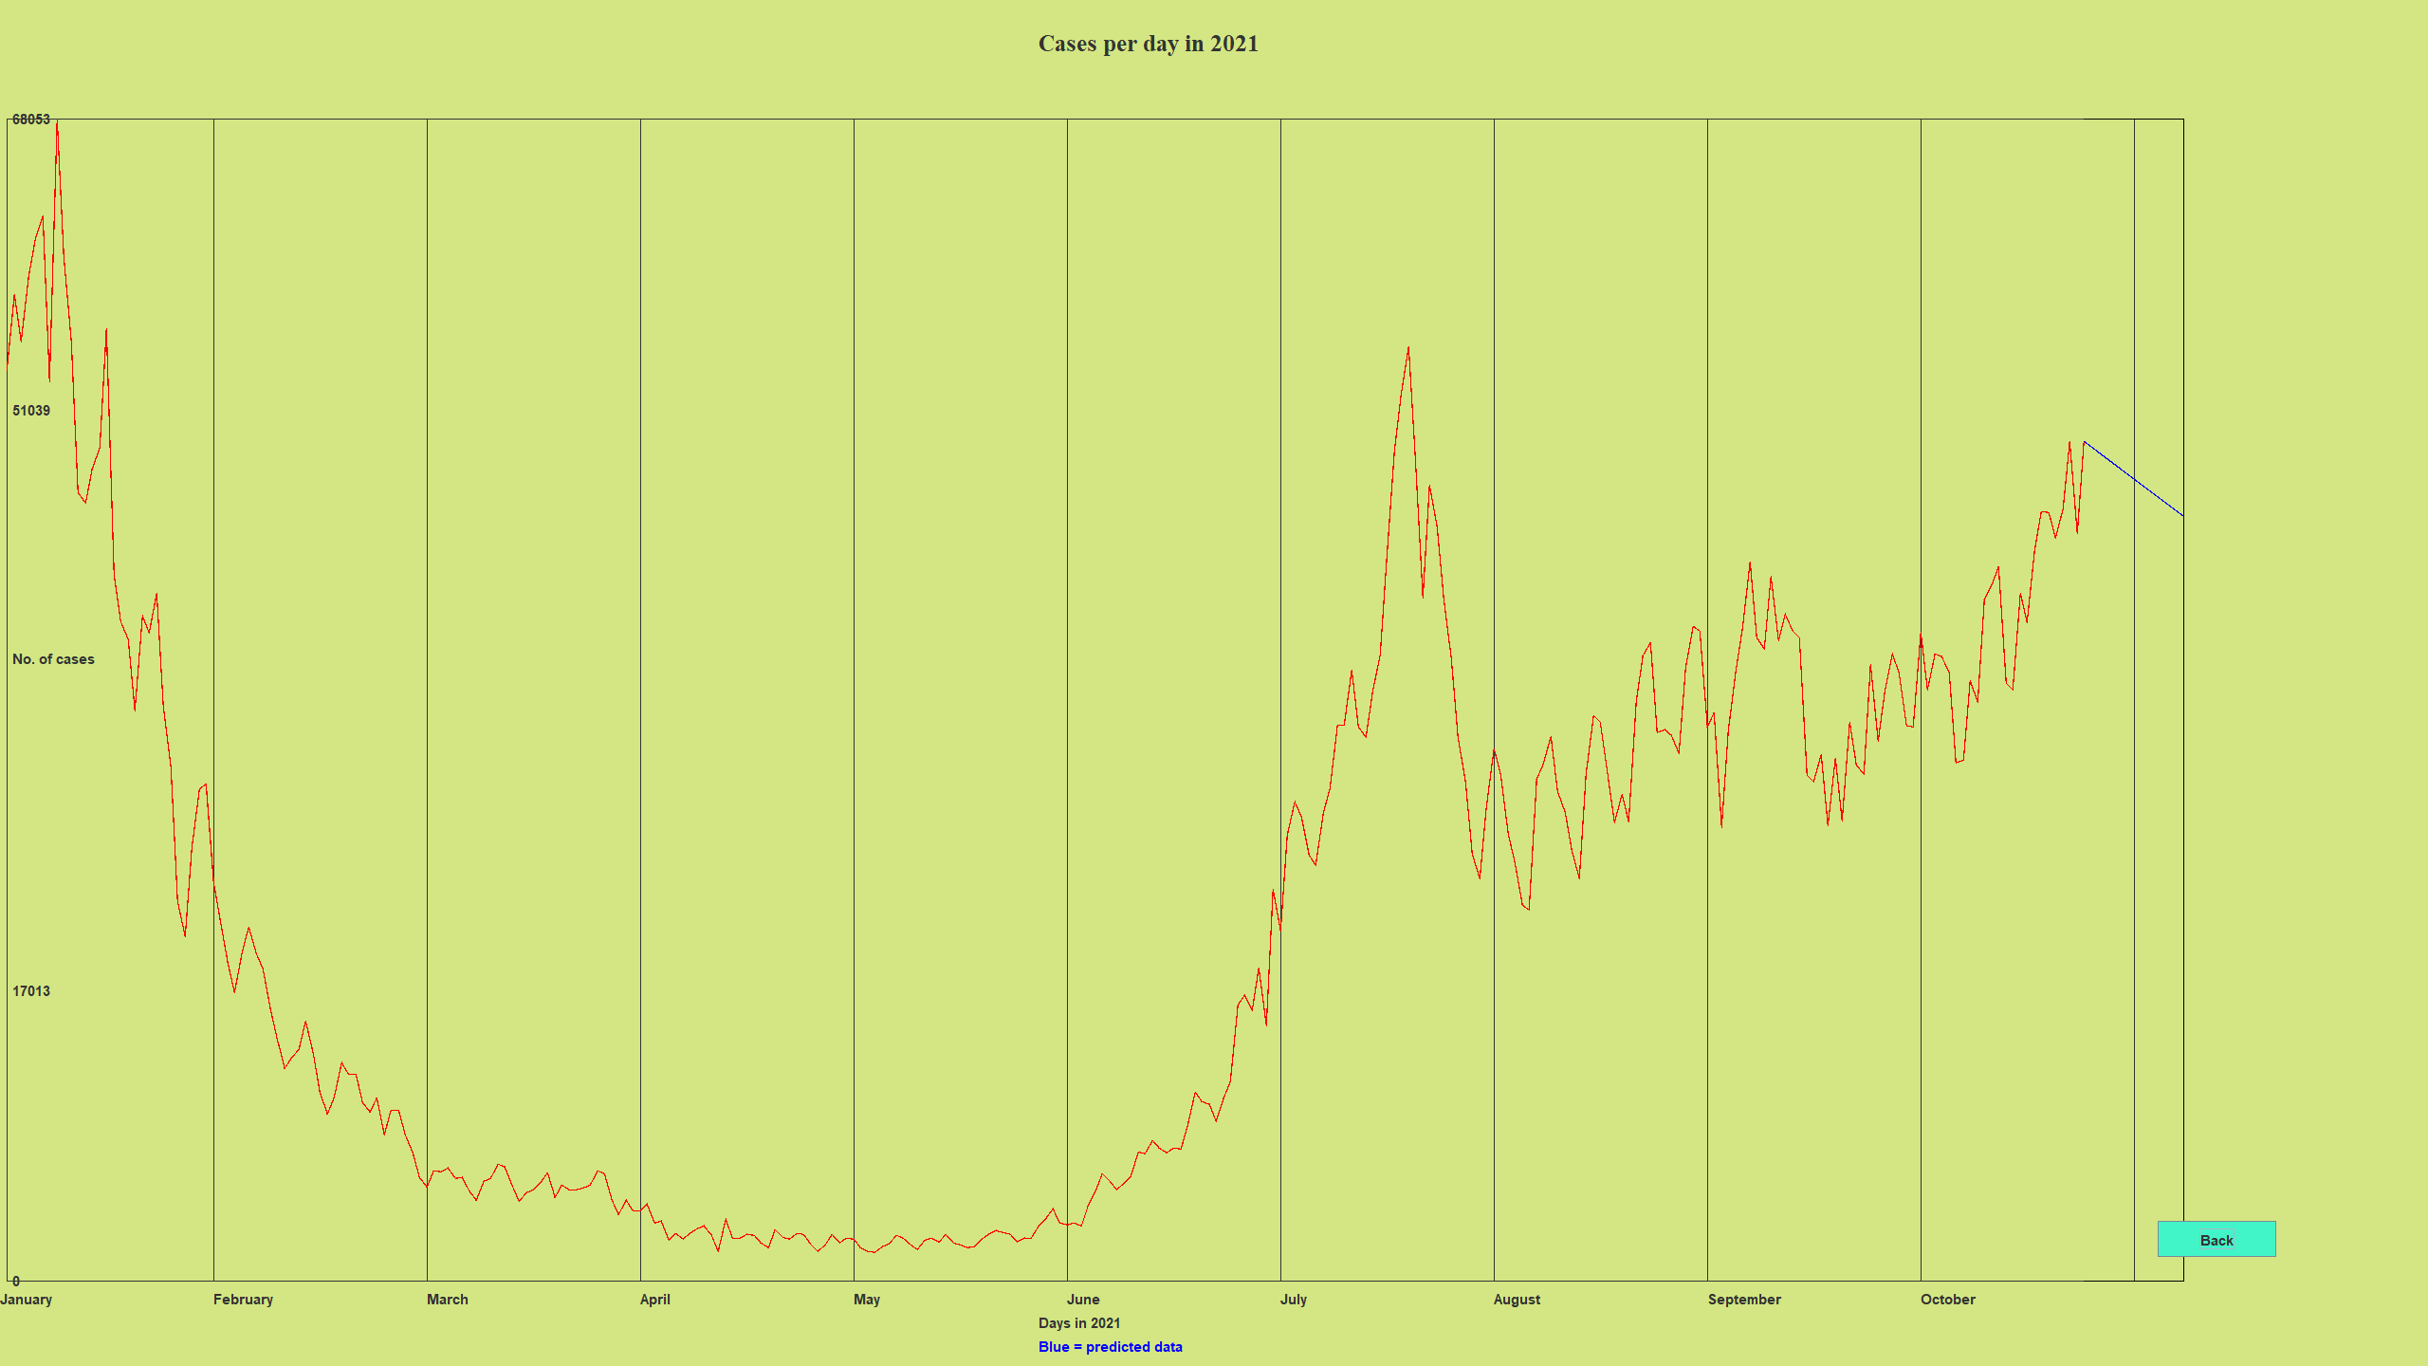
Prediction functionality

